Slide 1
Flask, REST, JSON
Recommendation Engine Framework Fundamentals
Gene Olafsen

Slide 2

Flask
A web framework.
A Python module that lets you develop web applications easily.
Has a small and easy-to-extend core.
A microframework that doesn’t include an ORM (Object Relational Manager) or requires other API's or frameworks to work out of the box.

Slide 3
REST
REST is acronym for REpresentational State Transfer.
It is an architectural style that defines a set of rules in order to create Web Services.
REST service API's may return XML or JSON responses. Though JSON is increasingly the preferred format because the JavaScript compatible format seamlessly integrates with web client frameworks. (data formats listed)
application/json
application/xml
application/x-wbe+xml
application/x-www-form-urlencoded
multipart/form-data

Slide 4
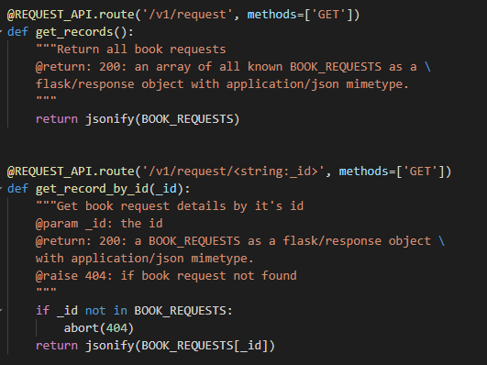
Flask URL Routes via Decorated Methods
todo

Slide 5
REST Principles
Stateless
State management that is required should take place on the client, not the server.
Client-Server
The loose coupling of the client and server enables each to be developed and enhanced independent of the other.
Uniform Interface
Resources should be uniquely identifiable through a single URL, and only by using the underlying methods of the network protocol.
Cacheable
All resources should allow caching unless explicitly indicated that caching is not possible.
Layerable System
Allows for an architecture composed of multiple layers of servers.

Slide 6
REST Scales
REST is useful in cloud applications and preferred for most inter-machine communication.
Stateless components can be freely redeployed if there is a failure.
REST systems can scale to accommodate load changes. This is because any request can be directed to any instance of a component; there can be nothing saved that has to be remembered by the next transaction.

Slide 7
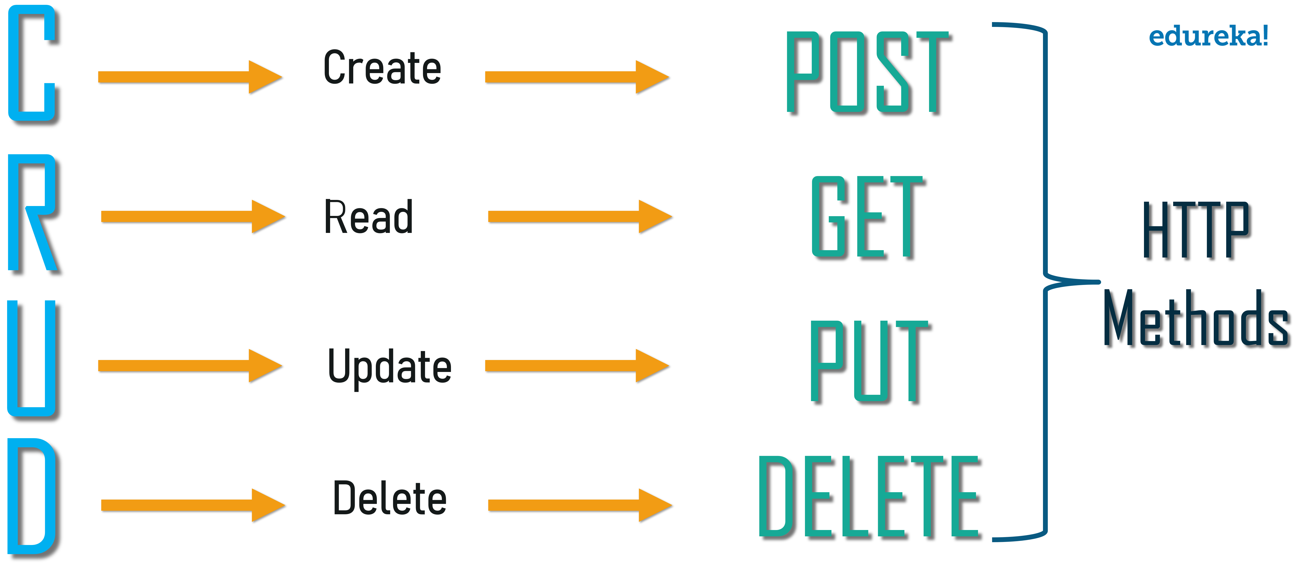
REST Methods

Slide 8
REST Practices
Endpoint consistency
Paths of endpoints are consistent by following common web standards.
Versioning
Typically a /V1 is part of the initial release of the endpoint.
Security
Secure via secure HTTP protocol.
Authentication
Web Tokens, OAuth 2.0 is common

Slide 9
Exercise REST Services
Curl
Postman
Swagger

Slide 10
Curl
Curl is a command-line tool for transferring data and supports about 22 protocols including HTTP.
This combination makes it a very good ad-hoc tool for testing our REST services.
Support:
DICT, FILE, FTP, FTPS, GOPHER, GOPHERS, HTTP, HTTPS, IMAP, IMAPS, LDAP, LDAPS, MQTT, POP3, POP3S, RTMP, RTMPS, RTSP, SCP, SFTP, SMB, SMBS, SMTP, SMTPS, TELNET and TFTP. curl supports SSL certificates, HTTP POST, HTTP PUT, FTP uploading, HTTP form based upload, proxies, HTTP/2, HTTP/3, cookies, user+password authentication (Basic, Plain, Digest, CRAM-MD5, SCRAM-SHA, NTLM, Negotiate and Kerberos), file transfer resume, proxy tunneling and more

Slide 11
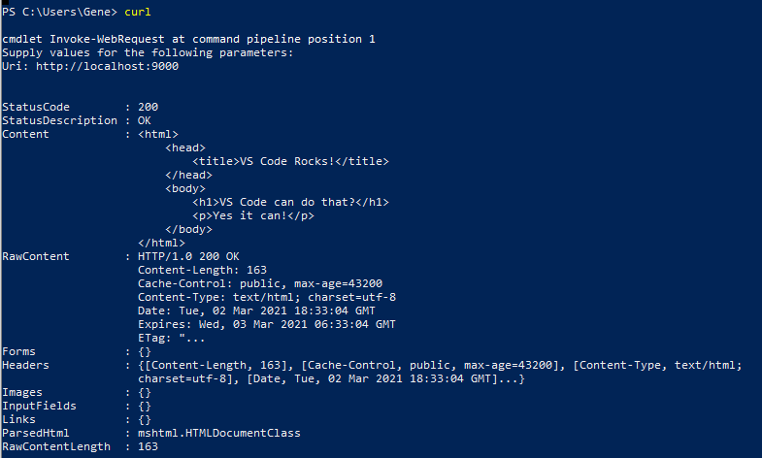
Curl Example

Slide 12
Postman
Send Requests and View Responses
Create and execute any REST, SOAP, and GraphQL queries from within Postman.
Application Choices
Download the App for Windows, MacOS or linux
Install the browser extension

Slide 13
Define Complex Requests
Send any type of request in Postman. Create and save custom methods and send requests with the following body types:
URL-encoded—The default content type for sending simple text data
Multipart/form-data—For sending large quantities of binary data or text containing non-ASCII characters
Raw body editing—For sending data without any encoding
Binary data—For sending image, audio, video, or text files

Slide 14
Postman Collections
Instead of creating calls manually to send over the command line, all you need is a Postman Collection.
Import a collection directly or generate one with one click from:
An API schema in the RAML, WADL, OpenAPI, or GraphQL format
A data file containing the cURL commands

Slide 15
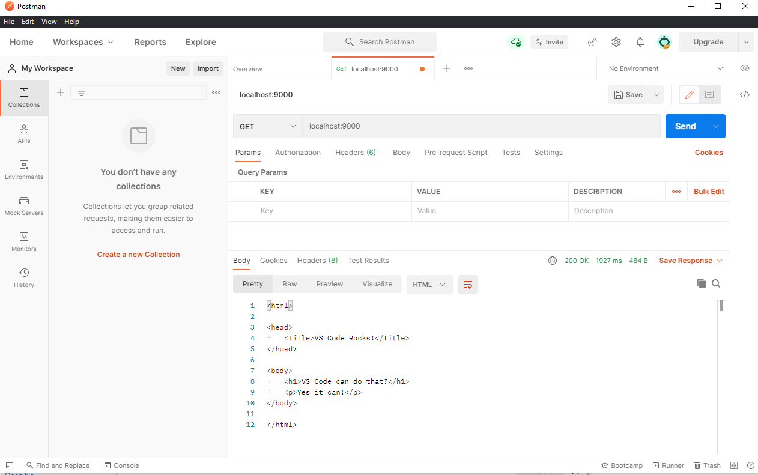
Postman Example

Slide 16
Swagger
Swagger is an Interface Description Language for describing RESTful APIs expressed using JSON.
Swagger is used together with a set of open-source software tools to design, build, document, and use RESTful web services.
Swagger includes automated documentation, code generation (into many programming languages), and test-case generation.

Slide 17

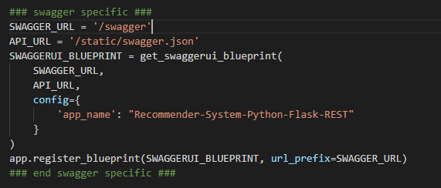
Enable Swagger
1. Add flask-swagger-ui library to requirements.txt
2. Boilerplate code to render the Swagger page

Slide 18
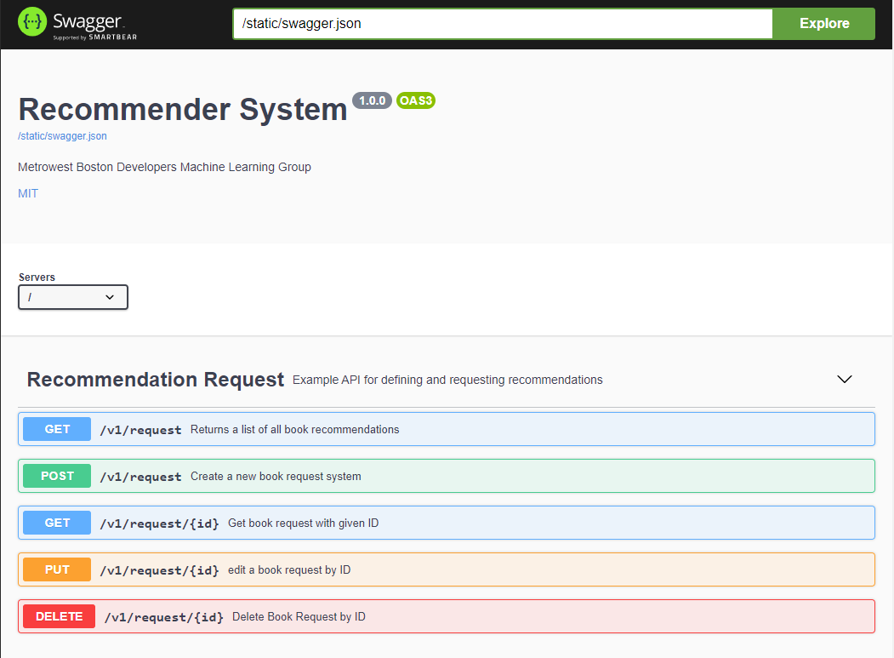
Swagger Interaction

Slide 19
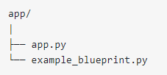
Flask Blueprints and Code Structure
As your code grows, it is not appropriate to contain everything in a single file.
Flask offers a way to structure your code to keep it maintainable and clear to understand... enter Blueprints!
Flask Blueprints encapsulate functionality, such as views, templates, and other resources.
Originally, all of the code resided in app.py
In a simple refactor, example_blueprint.py will contain the Flask Blueprint implementation. Then you modify app.py to recognize the additional code.

Slide 20
How Blueprints Work
A Flask Blueprint is not actually an application. It needs to be registered in an application before you can run it. When you register a Flask Blueprint in an application, you’re actually extending the application with the contents of the Blueprint.

Slide 21
High Level Recommendation
Select the recommendation engine type:
Content-based Filtering
Collaborative Filtering

Slide 22
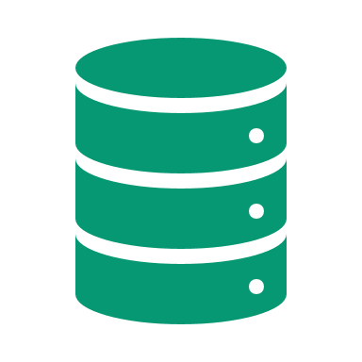


Recommendation Engine Goal
Configuration
Person Profile Data
Product Data
Configuration

Slide 23
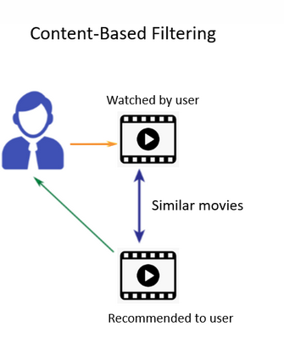
Movie Recommendation
Starting point: Content-based
Content-Based recommendation works on the principle that if a user likes a certain item then we recommend the user a similar item based on the item’s features or attributes.
If a user likes a movie of a particular genre or an actor then we recommend a movie along similar lines to our user.

Slide 24
Data Sources
A generic solution is possible when more than one data source is considered.
TMDB 5000 Movie Dataset | Kaggle
The Indian Movie Database | Kaggle

Slide 25

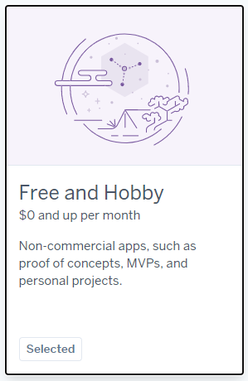
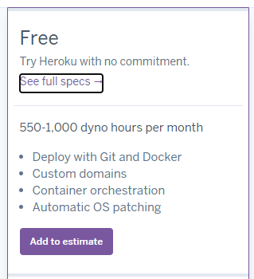
Deployment
Deploy your container to run in the cloud.

